Slide 1
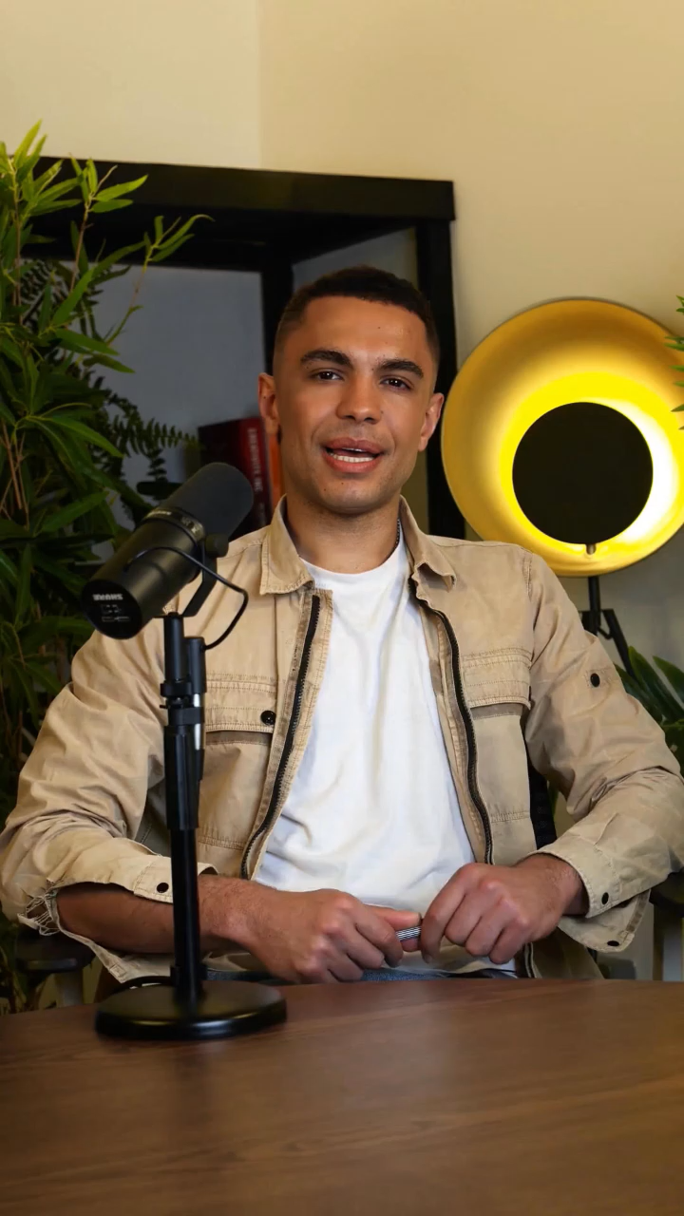
IOT HOUSEHOLD ATUOMATION
Presentation by:
Manav parikh
Dev patel
Aryan prajapati

Slide 2


INTRO TO DEVICE
This project seeks to design and implement a IoT device that integrates with various household appliances to digitalize and automate home management tasks.
Users will benefit from real-time power usage tracking and the ability to remotely control device power states, eliminating concerns about forgotten appliances and optimizing energy efficiency.

Slide 3



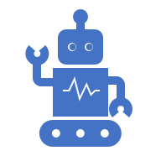

IINTENDED OUTCOME
A reliable, user-friendly system that:
Controls lights, fans, and AC units from a single touchpoint
Monitors real-time and historical power usage
Enables remote control via mobile app (iOS/Android)
Automates routines based on sensors

Slide 4
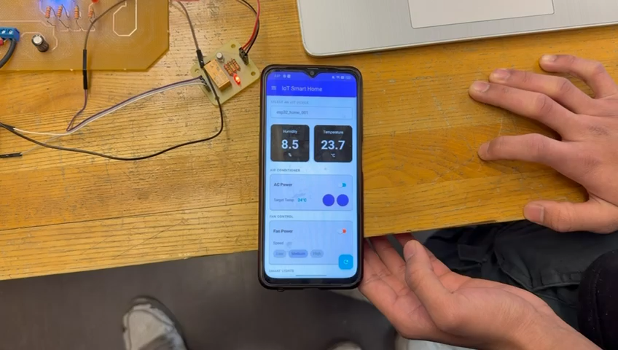
IDEMONSTARTION

Slide 5
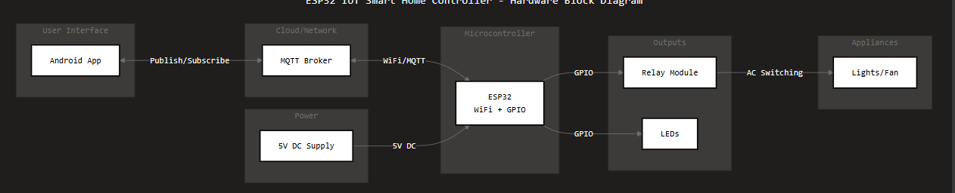
Block Diagram

Slide 6
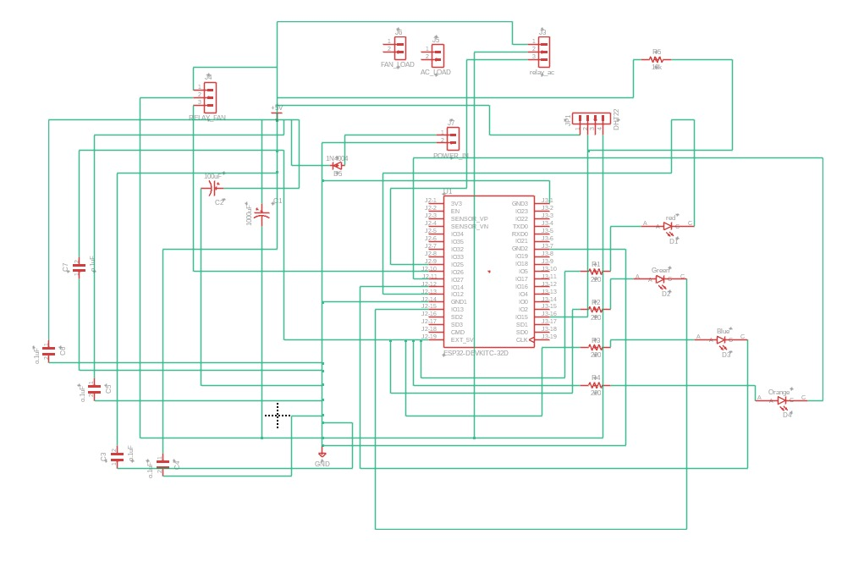
Schematic

Slide 7
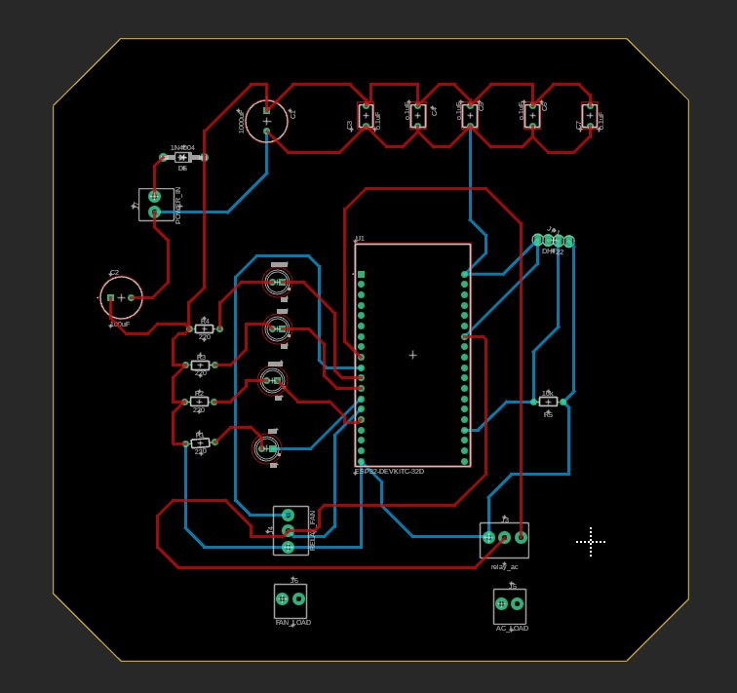
PCB LAYOUT

Slide 8
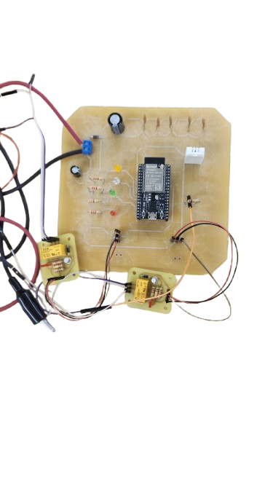
PCB/HARDWARE COMPNENTS
Capacitor
Jack
DHT22 Sensoe
Resistor
ESP-32
LEDs
Relay Module

Slide 9
BOM
EQUIPMENTS | PURCHASE DETAILS
DHT-22 (x1) | TOOL CRIB
ESP32 (x1) | TOOL CRIB
CAPACITORS (INCLUDING POLARIZED) (x7) | TOOL CRIB
RESISTORS (x5) AND LEDS (x4) | TOOL CRIB
DIODE (x1) | TOOL CRIB
5V RELAY MODULES (x2) | TOOL CRIB
FANS (x2) | TOOL CRIB
POWER_IN JACK (x1) | TOOL CRIB

Slide 10
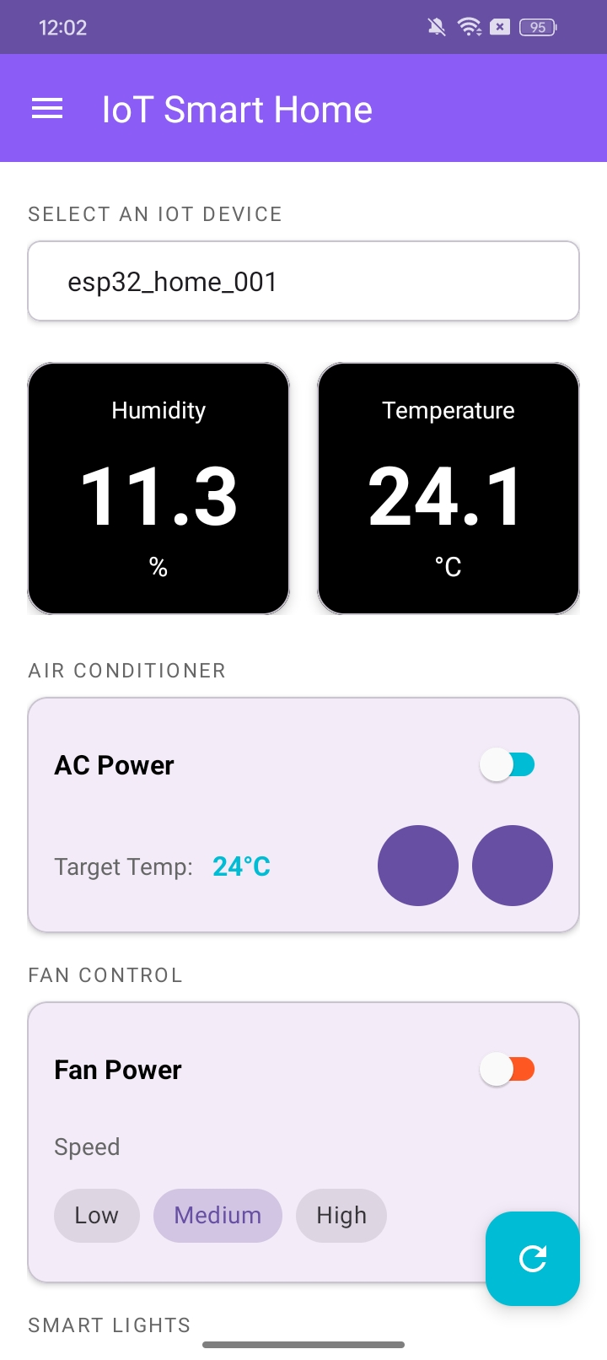
APP DESIGN PROCESS

Slide 11
App Design Process
MQTT Client (HiveCloud)
Used Hivecloud for MQTT comms.
Subscribed already with the topics establishing connection..
C Code
Sensor, client, Mqtt, leds, setup code done and tested.
Few functions regarding the working are also done.
Mobile Application
Tech used- Android studio.
Lang used- Kotlin

Slide 12
Future work.
Add more relays and household appliances.
More interactive modes in mobile application.
User specified login and security.
Touch panel.
Migration to cloud.
Implement AI model.
Product marketing, Helpdesk purpose website.

Slide 13
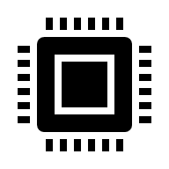

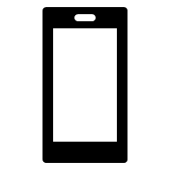
TESTING
Components
BROKER
APP
So, our all sensor ,esp32 ,relay works perfectly , That’s why we didn’t face problems in this area.
While working with broker we face problem as our program didn’t load and due to wrong topic names and subscription titles. But later in process it was fixed.
It was working fine from the beginning.

Slide 14
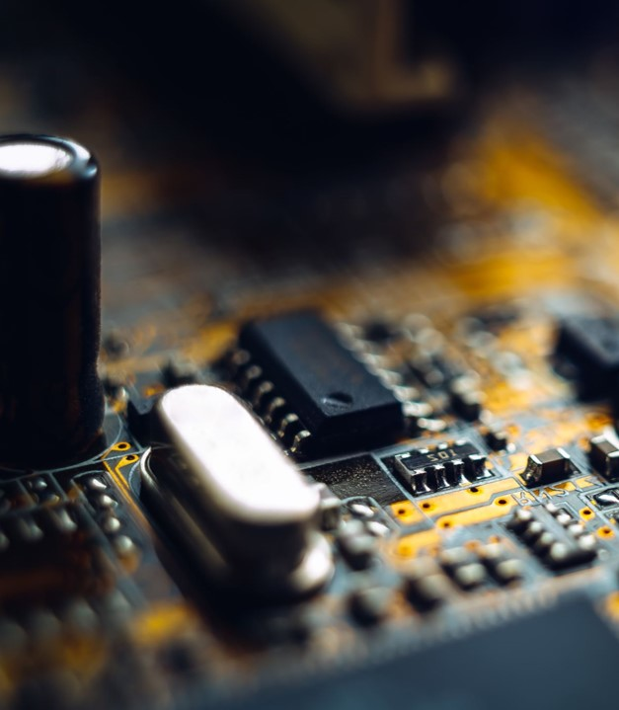
Lesson one summary
Conclusion
In conclusion, we successfully delivered a fully functional ESP32-based IoT Smart Home Controller that met all project objectives. The system consists of a physical unit that has been thoroughly tested and proven to operate safely under powered conditions. A fully functional Android mobile application was developed, enabling seamless WiFi connectivity between the user interface and the hardware. The project incorporates four or more core features, all accessible remotely through MQTT communication, allowing users to monitor and control home appliances from anywhere with an internet connection. This project demonstrates the practical implementation of IoT principles in a home automation context, combining embedded systems, wireless communication, and mobile app development into a cohesive and reliable smart home solution.

Slide 15

Thank you

